Slide 1

9896.HK
MINISO
LIFE IS FOR FUN
April 17th, 2025
Group 3: Kai Ren, Yang Lan, YiMing Jiang, Rui Hu, Gary Li, WeiJie Zhang
(Ordered by Pre)
Notes:
Good morning, professor and classmates.
We are group 3, and I’m RenKai. It’s a great honor to share our group’s project with you.
Our group project is about the IPO of MINISO, which happended in July thirteenth 2022.

Slide 2
CONTENTS & Framework
Was MINISO's IPO a Good or Bad deal ?
Valuation Preparation
Industry Analysis
Business Analysis
Finance Analysis
3
IPO Overview
Issue Shares
Issue Price
Raise Money
Valuation
Fundamental
Relative
2
4
MINISO Profile
Description
Development Path
Extension
Quantitative Trading Strategy
1
5
Notes:
Follow the project requirements, we are going to figure out: was MINISO’s IPO a good or bad deal ?
To solve this question, we build up such a framework, the core part is Valuation. We are going to do the Fundamental and Relative Valuation of the IPO.
In order to do the accurate prediction we need to do the deep analysis to get the right prediction logic.
First we need to know what is MINISO ? And the overview of IPO. Future we are going to discuss the industry, business and finance to know the basic logic of pricing.
Also, we are going to do some extension, especially think about how to build up a stratagy to earn money.

Slide 3
MINISO
PROFILE
01
1.1 Company Introduction
1.2 Development Path
Notes:
Here we go.

Slide 4





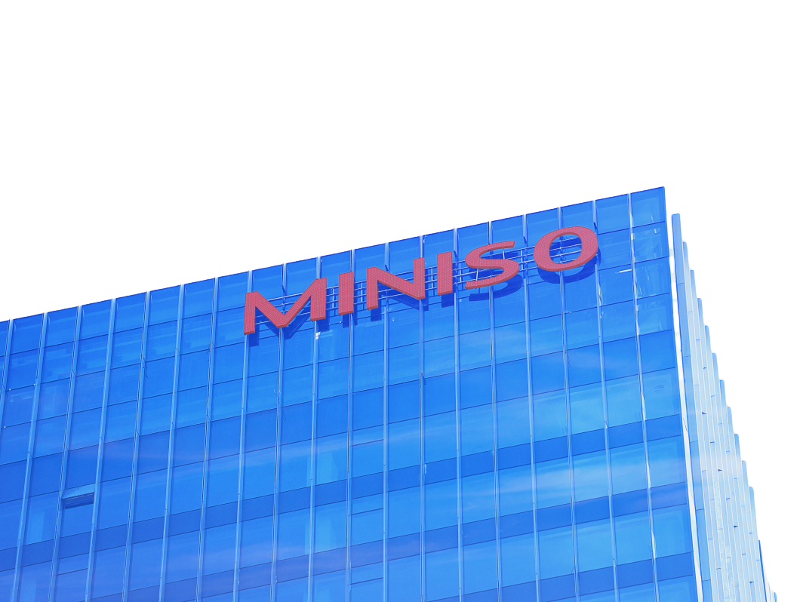

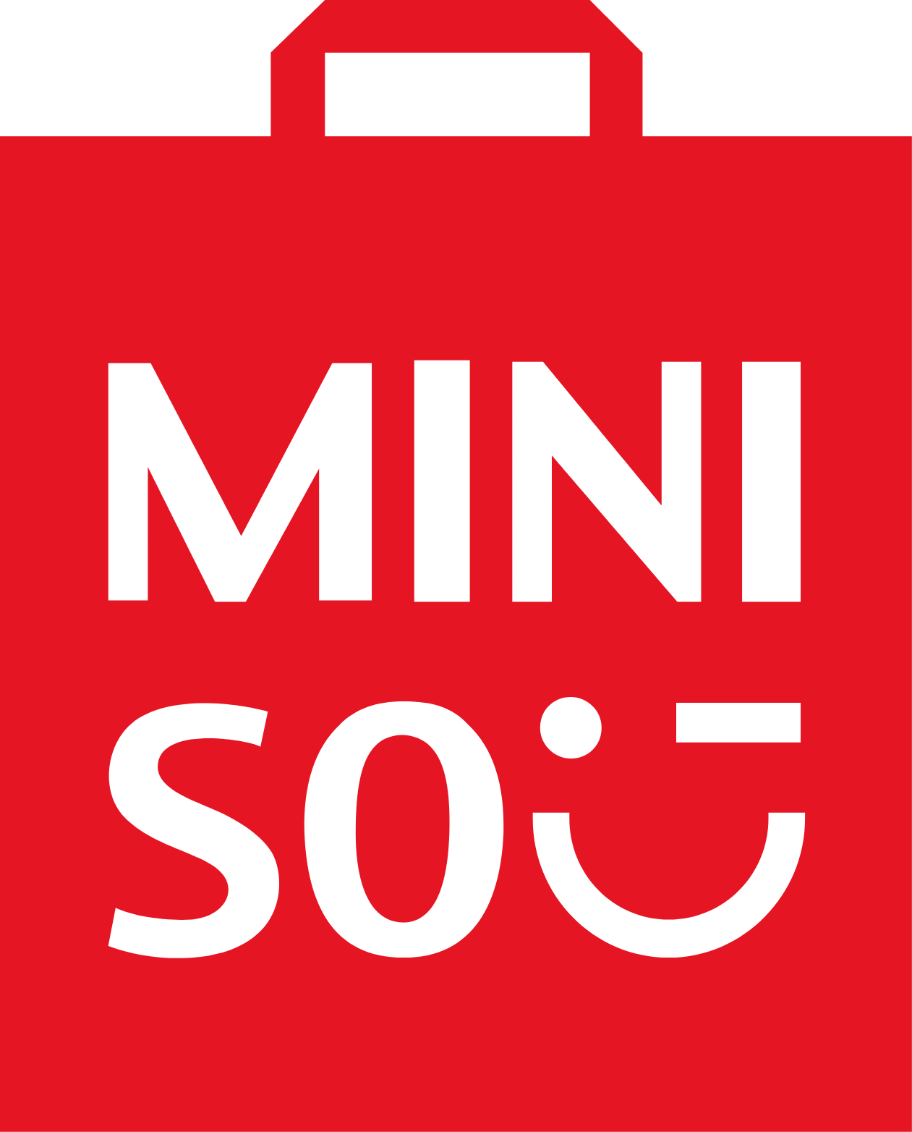
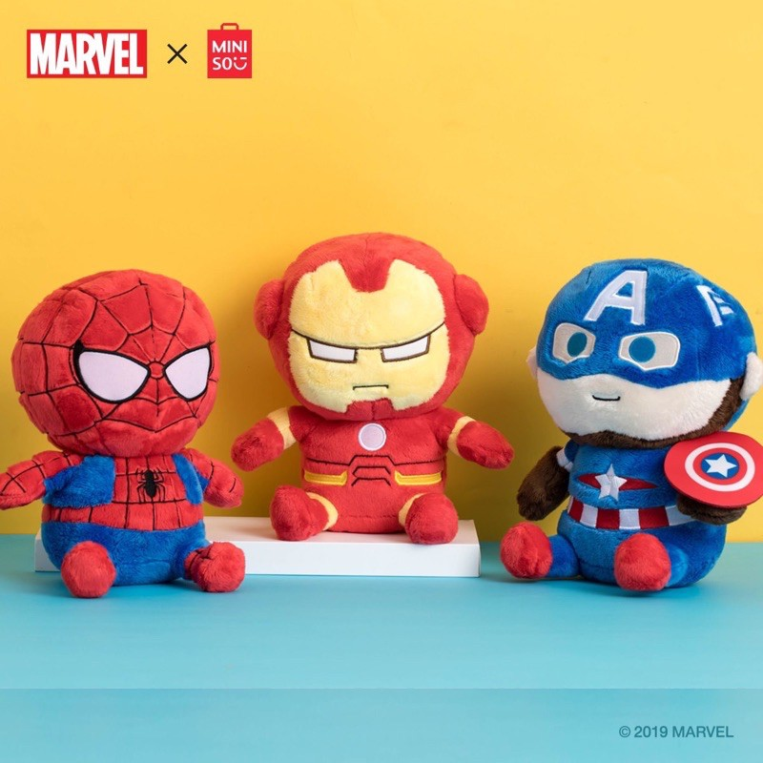
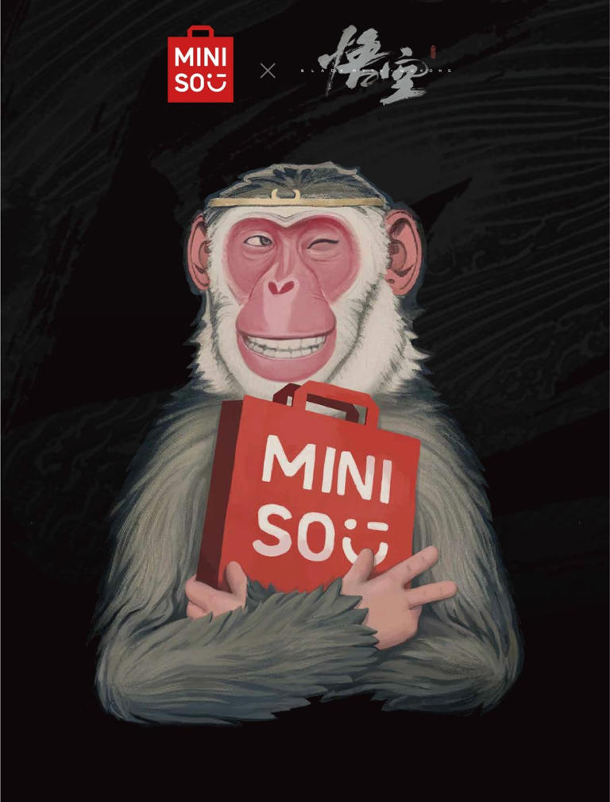

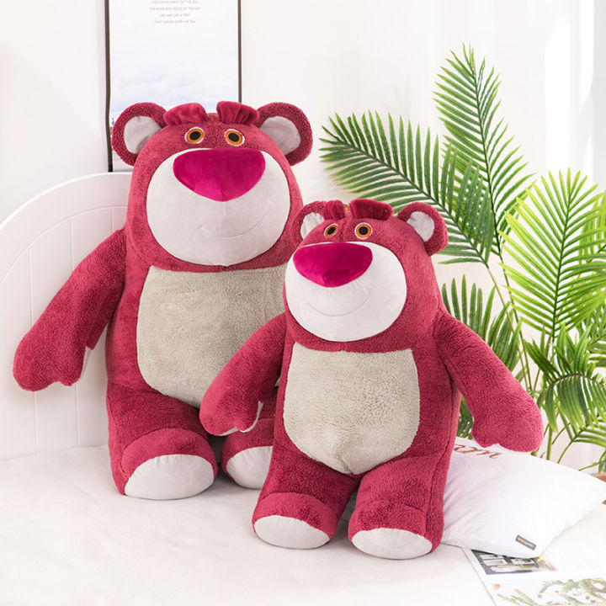
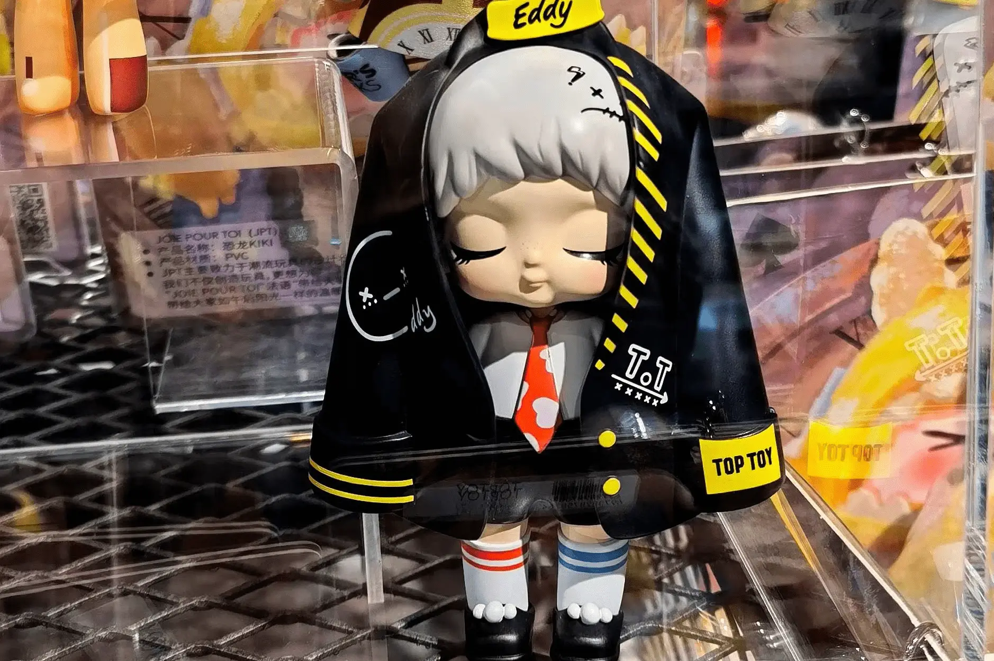
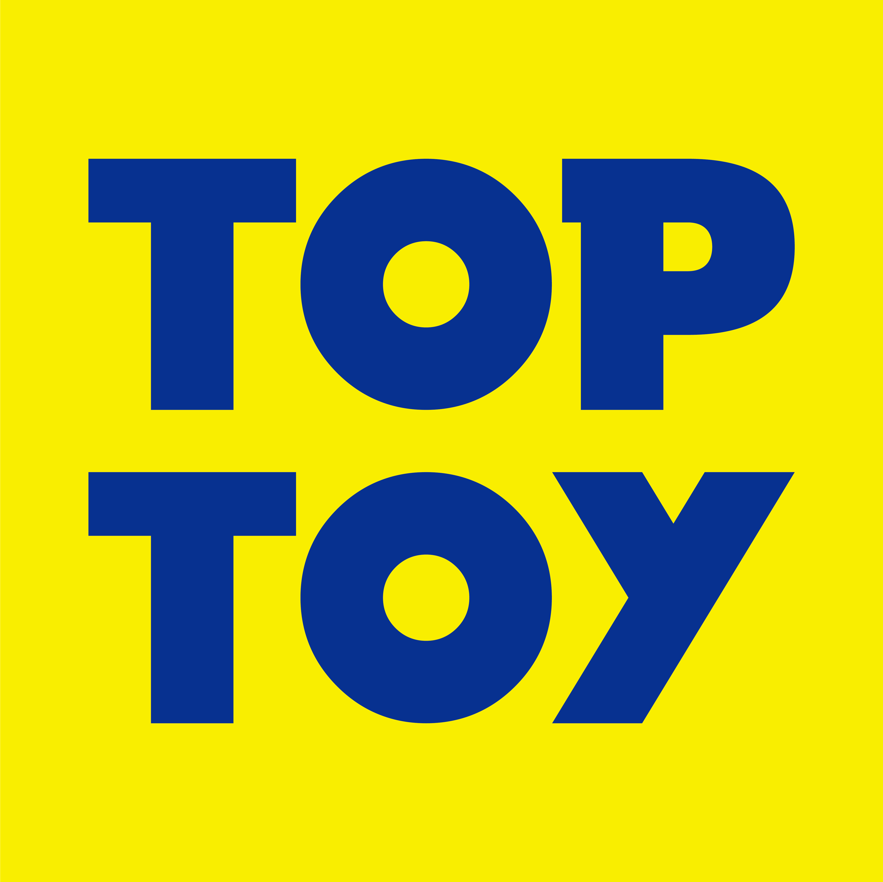
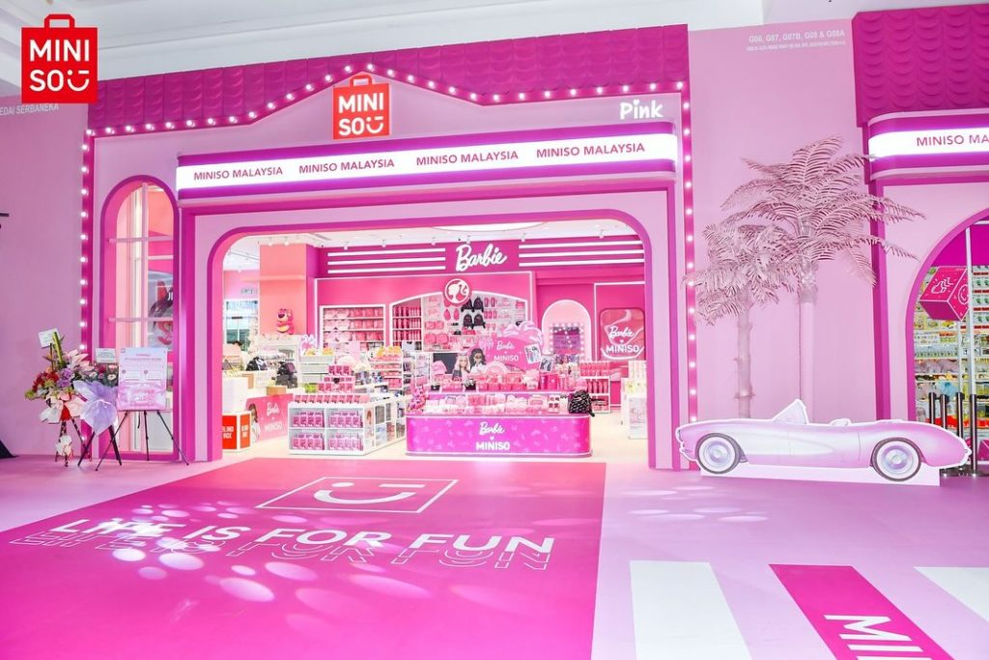

1.1 Company Introduction
Countries/Regions
Worldwide Stores
Member Users
Consumption
Cumulative Private Domain Users
7186 (MINISO)
234 (TOP TOY)
111
100 Million⁺
1 Billion⁺
4000 W⁺
Design
The world's LARGEST private label general retailer.
Founded in 2009, the company specializes in the fashion retail industry, focusing on the business philosophy of "interest consumption of young customer groups" and product posi-tioning of “high value, high quality, high cost-effective”.
At present, the company has successfully incubated TWO lifestyle brands: MINISO and TOPTOY (trend sub-brands).
Produce
Delivery
Sale
Renowned IPs
Associate & Create IPs
Retail Model that improves
"cost-efficiency-experience"
Fig 1.1 MINISO Core Business Framework.
Data Source: Topsperity Securities (2025.01.24)
Notes:
I think most of us have bought something in MINISO, and know what is it.
Brefly, MINISO is the world’s largest private lable general retailer, and now have two lifestyle brands MINISO and TOP TOY.
Just as the figure shows, the company will be associated with renowned Ips and create Ips to design produce delivery and sale the products.

Slide 5

1.2 Development Path
2015 – 2018
Growth Period
2022 (KEY POINT)
2019
2009 – 2014
Start-up Period
On July 13, it was listed on the Hong Kong Stock Exchange under a dual listing model.
The number of stores exceeded 4,000, more than 1,600 overseas, and the layout of more than 70 cities and regions.
2015
2009
Launch of the globalization strategy. By the end of the year, there were more than 1,000 MINISO stores.
Founder GuoFu Ye establishes MINISO.
2013
2023
Opened the first MINISO store in Guangzhou, China.
2020
Listed on the NYSE.
Launched TOPTOY.
With more than 6,600 stores. Upgraded its global brand strategy and positioned itself as a “lifestyle store featuring IP design”.
2017
On-line JingDong, Tmall.
2021
2014
2018
More than 5,000 stores and access to more than 100 geographic markets.
In August, the number of overseas stores exceeded 1,000.
In September, received a ¥1 billion investment.
At the end of the year, there were more than 300 MINISO stores.
2019 – Now
Strategic Upgrade period.
Data Source: Topsperity Securities (2025.01.24)
Notes:
After more than 10 years of development, though the Start up and Growth Period, Miniso was listed on the NYSE in 2020, and then listed on the HKSE of July 13 to face the strategic upgrade period.
And the IPO in honking is the key point we are going to discuss.

Slide 6
02
IPO
OVERVIEW

Slide 7

2. IPO Overview
Items | Information
Method | Dual Primary Listing
Date | 2022/7/13 (Why ? Strategic Transformation and Upgrading. Post-Epidemic Market Recovery and Valuation Repair. Capital Operation Requirements: Top Toy will be listed within 3 years).
Size | The issue of 41 million shares (3.4% of the total share capital before the issue) at an issue price of HK$13.8 raised approximately HK$412.8 million.
First Day Return | -3.04%
After ten years of rapid development, MINISO has become a new consumer retailer driven by design and R&D, with online and offline co-development.
Top 100
China Franchise
Chain Companies
Top 500
Chinese Companies
Funds Raised Will be Used for
Market
Low
Recognized
by the Market
Stable Period
Expansion and upgrading of store network.
3. Iteration of technological competence.
2. Optimization of supply chain core competence and product development.
4. Replenishment of liquidity.
5. Brand cultivation.
Fig 2.1 MINISO's share price trend since its issuance.
Data Source: MINISO Prospectus (2022.06.30), Soochow Securities (2022.07.18), Wind
Notes:
Talking about the overview of this IPO.
In 2022 MINISO has become the top 500 chinese companies, and the IPO is happened inJuly 13th 2022.
Facing 5 requirments, we think the key reason for MINISO to do IPO are aaa aaa.
Although after IPO there comes to a Market Low point, but after that it is recognized by the market.
为什么这个点上市？
战略转型窗口期：此时上市可强化“IP生态”标签，吸引资本市场关注；TOP TOY孵化成熟​​。
疫情后市场复苏与估值修复：​​零售行业触底反弹​​ 2022年全球疫情进入缓和期，中国社零总额同比增速回升至3.5%（2022Q2），消费板块估值修复。MINISO通过“超级门店”策略（如纽约时代广场店）验证海外扩张韧性，2022年全球门店达5791家，海外收入占比提升至32.7%. 规避早期疫情不确定性​​ 2020-2021年疫情期间，零售企业IPO估值普遍承压（如泡泡玛特2020年港股上市市盈率仅40倍，低于疫情前预期）。2022年市场情绪回暖，MINISO港股发行市盈率约20倍，平衡了风险与增长预期。
资本运作需求：融资与分拆的双重目标，​​补充扩张资金​​ 2022年MINISO计划新增500家海外门店（重点布局东南亚、拉美），单店成本约50万元，总需2.5亿美元。港股IPO募资约5亿美元，可支撑3年扩张计划。为TOP TOY分拆铺路​​ 分拆潮玩业务需独立财务数据支撑。2022年TOP TOY营收占比已达5.7%，若过早上市可能稀释主品牌资源；过晚则错失潮玩赛道估值红利（泡泡玛特2021年市值超千亿港元）。2022年上市为后续分拆预留操作空间
后续基本实现了预期目标

Slide 8
Valuation Preparation
03
3.1 Industry Analysis
3.2 Business Analysis
3.3 Finance Analysis
Notes:
Now we have know why MINISO choose IPO in 2022, but What is the underlying logic for pricing MINISO?
We need to do further analysis for this company. Let’s welcome Lan Yang.

Slide 9

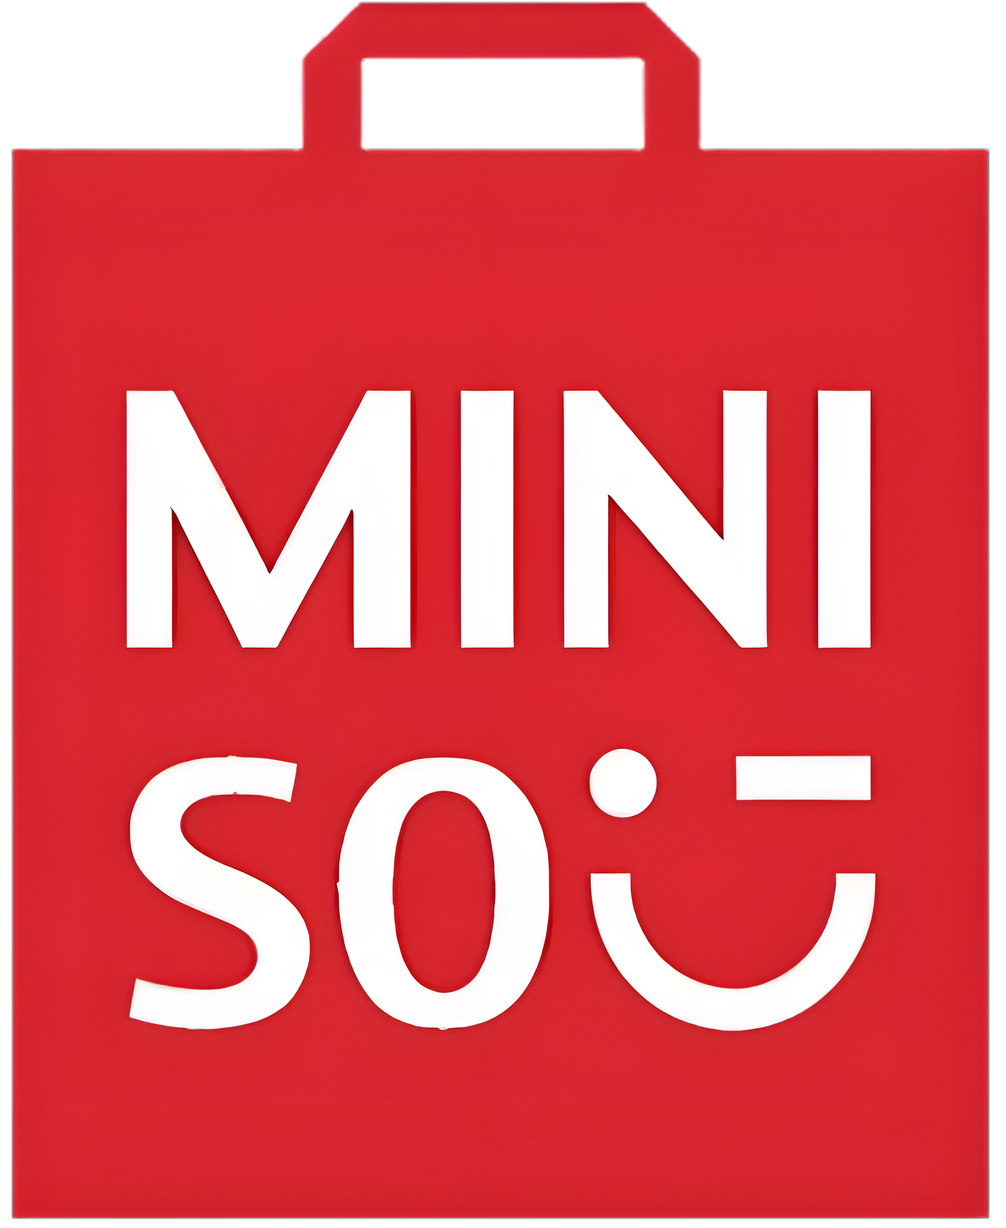


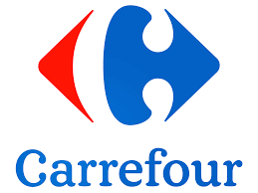
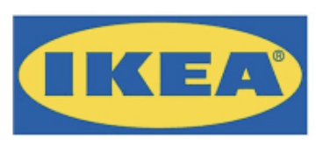
3.1.1 Industry Analysis: Home Lifestyle Retail
Market of Home Lifestyle Retail
7.3% CAGR
Specialty Store
Private-brand
Supermarket
Fig 3.1 Market size of home lifestyle retail in China (GMV).
Private-brand (MINISO): Refers to retailers that distribute various home lifestyle products, with > 50% of their total GMV derived from private label home and lifestyle products.
The Home Lifestyle Retail Market Integrated Retail Space is Broad and Promising!
Fig 3.2 Market size of private-brand in china (GMV).
Data Source: Wind

Slide 10
3.1.2 Industry Analysis: Private-brand Retail
Global
Domestic
Market Fragmentation: Global CR3 is 17.5% (2021), showing moderate consolidation.
Strategic Differentiation: Unlike minimalist (MUJI) or ultra-low-cost (DAISO) positioning, focuses on "super IP" collaborations and lifestyle branding.
Low Concentration: CR5 is just 18.6% (2021), reflecting intense competition.
MINISO’s Lead: Holds 11.4% share, doubling the next competitor. 1,000+ retailers generated ¥10.8B GMV (2021), with rapid growth potential.
Fig 3.3 Top 5 Global private-brand retail companies by GMV (2021).
Fig 3.4 Top 5 Domestic private-brand retail companies by GMV (2021).
This sector is competitive both domestically and globally, with MINISO leading in market share.
Data Source: Wind

Slide 11
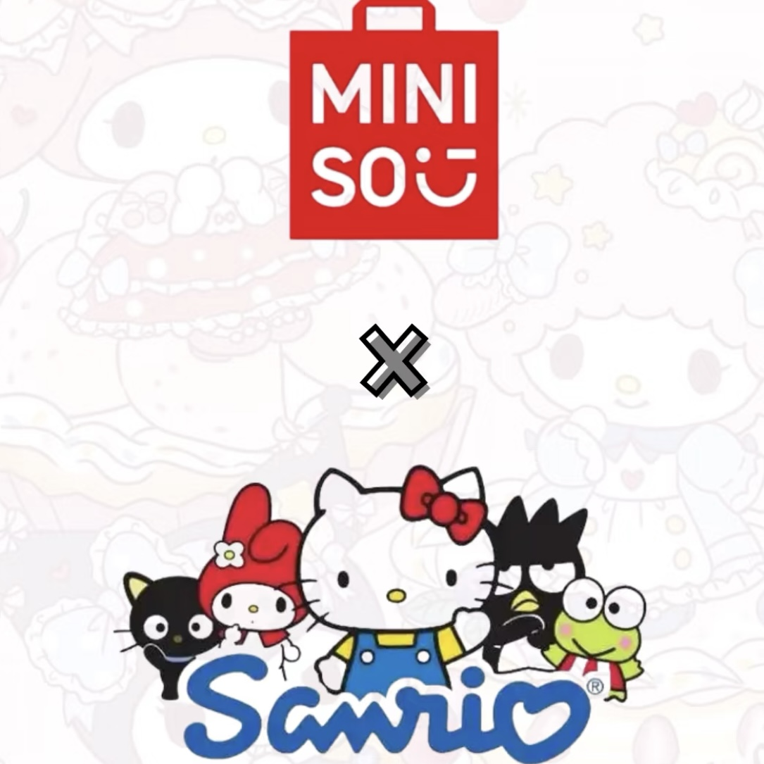
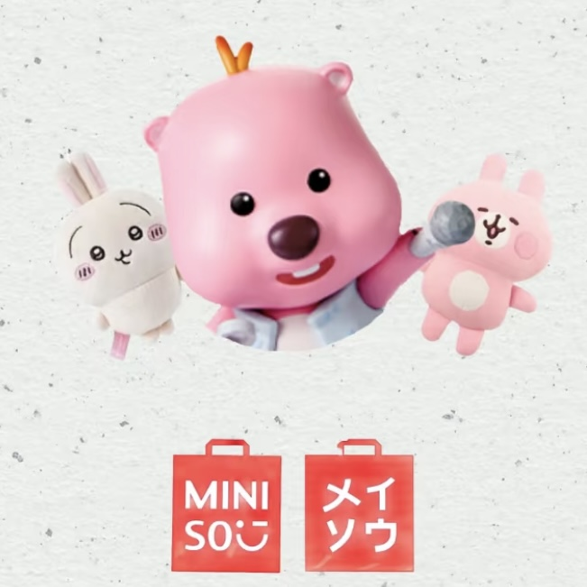
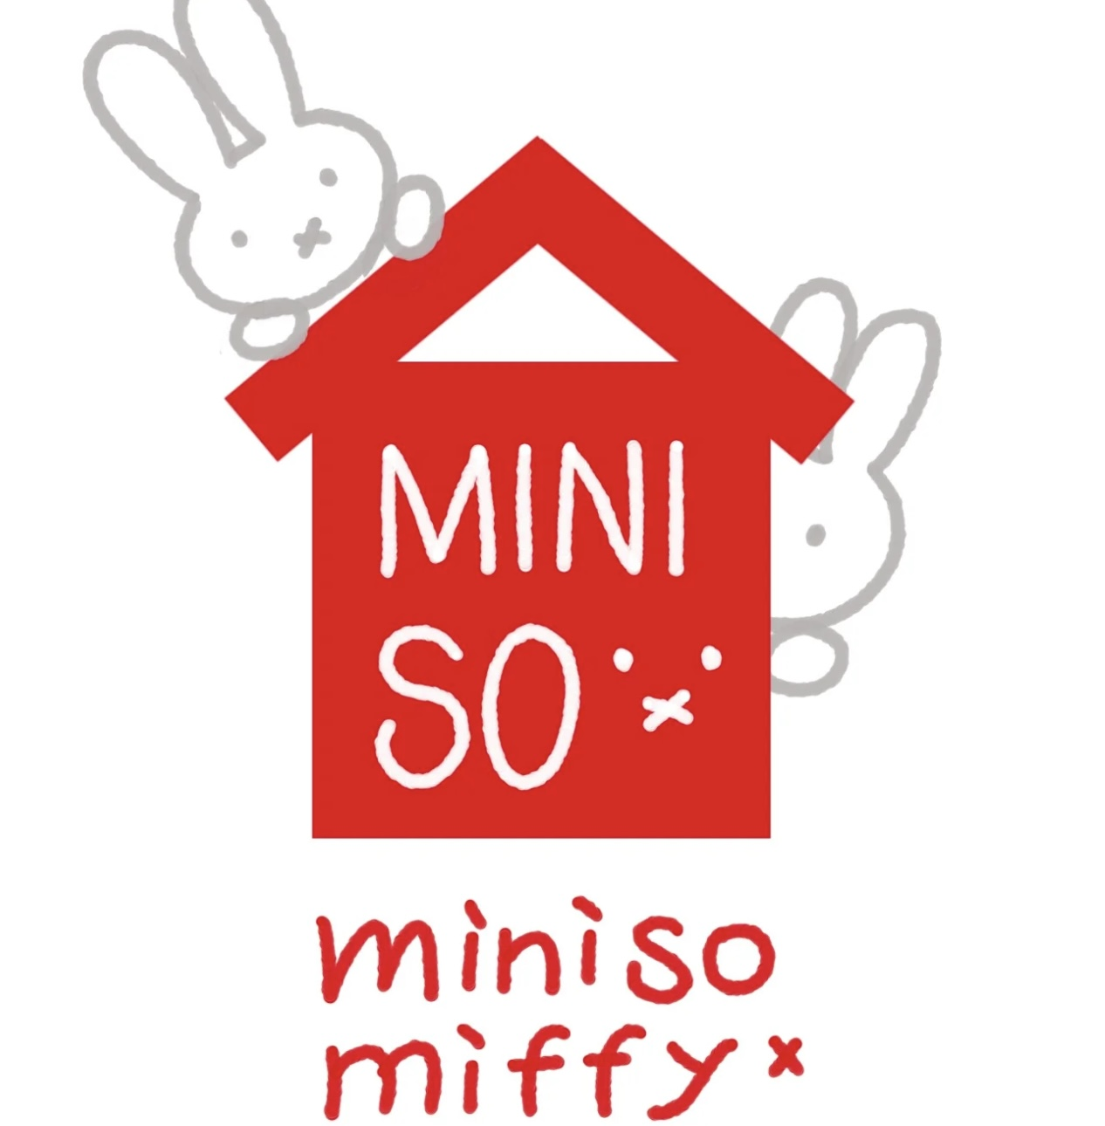



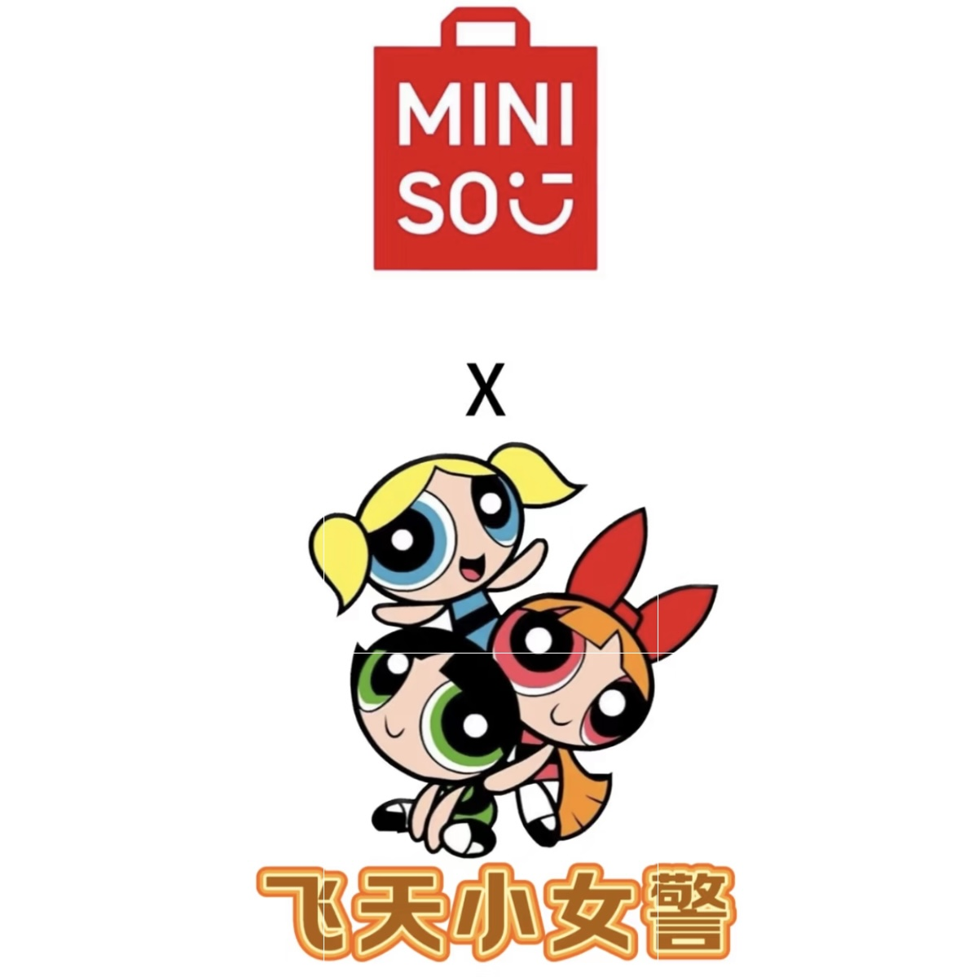
3.1.3 Industry Analysis: Trendy Toy
Private-brand Retail
Art toys
Dolls
Collectible Figures
Assembly Toys
Blind Box
Others
Industry
Trendy Toy
Global: Growth driven by premium IP ecosystem development and supply chain integration.
Domestic: Explosive growth in blind box, led by domestic innovation.
Fig 3.5 China’s trendy toy market size (GMV).
22.8% CAGR
IPs collaborated with Trendy Toy Examples:
2020
2021
Data Source: Wind
Fig 3.6 Global trendy toy market size by retail value.

Slide 12
3.2.1 Business Analysis: Product-Driven
“711” Strategy
High Aesthetics
7
1
1
Launch approximately 100 new SKUs
A new cycle every 7 days
Three Highs
(Product Advantages)
High Frequency
High Quality
Selecting from 10,000 product ideas
Low Cost
Three Lows
(Operational Edge)
Low Price
Low Markup
Fig 3.7 MINISO SKU Number.
Data Source: Wind

Slide 13





3.2.1 Business Analysis: Product-Driven
Traditional Supply Chain
MINISO Supply Chain
Direct supply from high-quality suppliers.
Centralized negotiation with scale of over 5,300 stores, leveraging volume to reduce price.
Supplier
Supplier
Stores
Smart stores achieve full digitalization.
High-frequency data communication with suppliers
Multi-level
Distribution
Offline-to-private-domain traffic conversion.
Promote O2O consumption loop.
Private-domain users + platforms like Meituan and Eleme.
Offline Consumers
Consumer
Information Asymmetry
High Costs
Vertical Integration
Breaking Information Barriers
Reducing Costs and Improving Efficiency
Global Collaboration with High-Quality Suppliers: over 1,400 suppliers.
Bulk Procurement Enhances Bargaining Power: the procurement cost ratio from the top five suppliers decreased to 8.4%, while the largest supplier's share dropped to 1.9%.
Data Source: Wind
Fig 3.8 Procurement cost of Top 5 Suppliers.

Slide 14


3.2.2 Business Analysis: Channel-Driven
Strategy: Light-Asset Franchise Expansion, Flexible Store Formats. Adapting to Local Conditions with Flexible Layouts — Three Store Types Driving Growth Together.
One-Stop, Strongly-Controlled Franchise System
“Next-Day Revenue Sharing System”
“Next-Day Revenue Sharing System”
Franchisee
Strongly-Controlled
Initial Investment & Daily Expense
Stores
Product Deposit System: one-time paid & no stock pressure
In FY2020, over 90% of MINISO's revenue came from franchisees and distributor channels.
Data Source: Wind
Fig 3.9 Franchise/Distributor channel contributed of total revenue in FY2020.
Fig 3.10 Stores counted by categories.

Slide 15
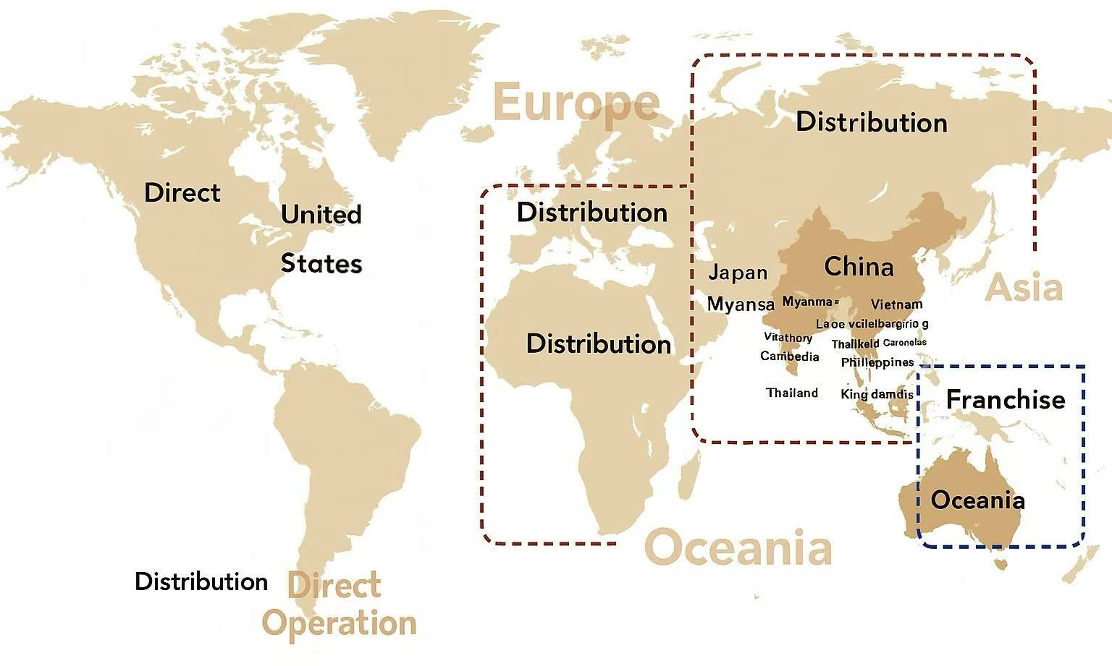
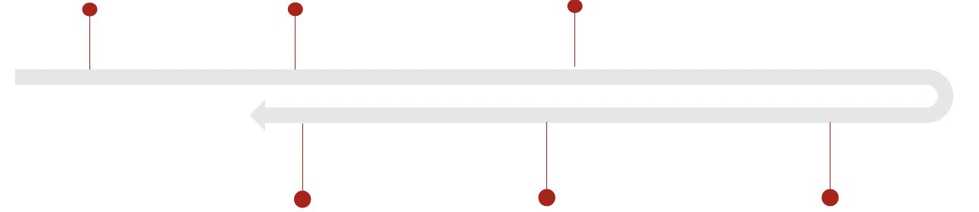
3.2.2 Business Analysis: Channel-Driven
Overseas Business Expansion
Localized Business Model
Conference
in Brazil
2018.4
Global forum
in Mexico
2019.6
M&O PARIS
Fall Exhibition
2019.6
2021.9
7 new stores in India
2021.9
Flagship’
New York store
2020.8
MINISO first store
In European country
Data Source: Wind
Fig 3.12 Revenue by region (in millions yuan).
Fig 3.11 Numbers of stores counted by district.

Slide 16




3.3.1 Financial Analysis: Overview
Revenue Remains Sluggish
GPM Fluctuates Significantly
The Operating Revenues from 2019 to 2022 were RMB 9.39 billion, 8.97 billion, 9.07 billion, and 10.08 billion, respectively.
Significant Decline during 2020 – 2021 but a rebound in 2022.
Fig 3.13 Total operating revenue for fiscal years 2019 - 2022.
The Gross Profit Margins from 2019 to 2022 were 26.7%, 30.4%, 26.7%, and 30.4%, respectively.
 | 2019 | 2020 | 2021 | 2022
Gross Profit Margin in China (%) | 0.257 | 0.275 | 0.249 | 0.251
Overseas Gross Profit Margin (%) | 0.289 | 0.365 | 0.347 | 0.421
Due to the impact of the international business, the gross profit margin has continued to fluctuate.
Fig 3.14 Gross profit margin for fiscal years 2019 - 2022.
Data Source: MINISO Prospectus (2022.06.30), Wind

Slide 17










3.3.1 Financial Analysis: Overview
Declining Operating Profit
Expanding Net Loss
Sufficient Cash Flow
Short Turnover Days
The Operating Profit from 2019 to 2021 were RMB 10.09 billion, 7.45 billion, and 4.13 billion, respectively.
The Net Loss from 2019 to 2021 were RMB -2.90 billion, -2.62 billion, and -14.15 billion, respectively.
COVID-19
Given relatively stable revenues, the increase in costs and expenses has placed pressure on profitability.
Fig 3.15 Operating profit for fiscal years 2019 - 2022.
Tab 3.1 Main financial indicators for fiscal years 2019 - 2022
From 2019 to 2022, MINISO's cash and cash equivalents were 1.5, 2.8, 6.7, and 5.3 billion RMB, respectively.
The inventory turnover days from 2019 to 2022 were 63, 78, 78, and 69 days, respectively.
 | 2019 | 2020 | 2021 | 2022
Debt to Assets Ratio | 102.2 | 105.5 | 37.9 | 37.7
Current Assets / Total Assets | 86.3 | 85.4 | 85.9 | 71.6
Current Liabilities / Total Liabilities | 60.8 | 53.7 | 85.9 | 89.1
Current Ratio | 1.4 | 1.5 | 2.6 | 2.1
Operating Cycle | 104.2 | 92.8 | 92.4 | 82.3
Inventory Turnover Days | 62.7 | 77.9 | 78.4 | 68.9
Accounts Payable Turnover Days |  | 32.3 | 30.7 | 33.2
Total Asset Turnover Ratio | 2.1 | 1.6 | 1.1 | 0.9
Sufficient operating cash flow and Low turnover days supported by supply chain advantages.
fast-moving consumer goods
supply chain advantage:
shelves rather than warehouses
Data Source: MINISO Prospectus (2022.06.30), Wind

Slide 18






3.3.2 Financial Analysis: Challenges Ahead
Recovery of Operations ?
Store Closures
Decreased Passenger Flow
Obstacles in Overseas
Markets
Evidence: The number of store closures peaked at 233 in 2021, and although it decreased in 2022, it still remained higher than pre-pandemic levels.
Evidence: From the 2019 to 2021, MINISO’s same-store sales were 2.7 million, 2.2 million, and 1.9 million RMB, respectively, showing a noticeable downward trend.
Fig 3.16 Annual number of MINISO partner store
closure in China for fiscal years 2019 - 2022.
Fig 3.17 Same-Store Sales for fiscal years 2019 - 2022.
Data Source: MINISO Prospectus (2022.06.30), Wind

Slide 19




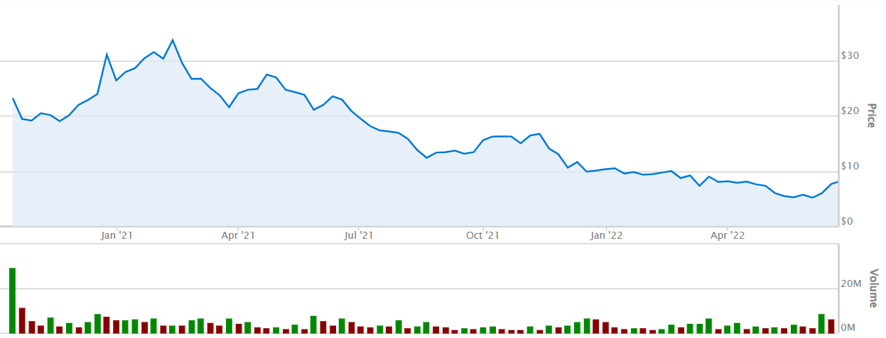

3.3.2 Financial Analysis: Challenges Ahead
Long-Term
Strategically important for brand enhancement and market expansion.
Rising Costs !
Short-Term
Exerts cost pressure and compresses profit margins.
Business
Promotion
Brand
Collaborations
Store
Expansion
Fig 3.18 Expenses for fiscal years 2019 - 2022.
May 2022
I think several U.S.-listed Chinese companies are facing delisting risks.
We need a dual primary listing to mitigate potential delisting risks in the U.S.
Fig 3.19 MINISO’s U.S. stock (MNSO) price (2020.10 - 2022.06)
U.S. Securities and Exchange Commission (SEC)
Data Source: MINISO Prospectus (2022.06.30), Wind

Slide 20
















3.3.2 Financial Analysis: Rationale and Necessity of the IPO
Business
Promotion
Brand
Collaborations
Store
Expansion
COVID-19
Declining Revenue
Rising Costs
Store Closures
Supply chain
disruption
Decreased Passenger Flow
Declining Single Store Revenue
External Risks
Underperformance in the U.S. stock market
With declining revenue per store, MINISO will have to rely on store expansion to grow the pie.
Looming threat from the SEC
Pursuing a listing in Hong Kong has become not only a reasonable but also a necessary step.
Data Source: MINISO Prospectus (2022.06.30), Wind

Slide 21
04
Valuation
4.1 FCF Forecast
4.2 Fundamental Val
4.3 Relative Val

Slide 22
4.1 Free Cash Flow Forecast Framework
Predicted revenue growth from the prospectus to derive future FCF projections.
Baseline Method: Estimate FCF by Prospectus CAGR.
Data given by MINISO Prospectus (2022.06.30)
Year (Million RMB) | 2023E | 2024E | 2025E | 2026E | 2027E
Forecast FCF | 1280.48 | 1462.31 | 1669.96 | 1907.09 | 2177.90
Direct Operated Stores
The epidemic is fluctuating but recovering.
Stable single store revenue.
Year | Growth Rate
2023 | 10%
2024 | 12%
2025 | 12%
2026 | 12%
2027 | 12%
Domestic
Domestic penetration tends to be mature and stable.
revenue share
66% → 56% → 47%
Third Party Stores
Estimated growth of store quantity: 400/350/320.
Covid-19 restrictions for stores are removed, leading to revenue rebound since stores are reopening.
Direct Operated Stores
Master Brand
Overseas
America 4%
Asia 22%
Latin America and Europe 12%
Year | Growth Rate
2023 | 35%
2024 | 40%
2025 | 38%
2026 | 35%
2027 | 35%
Third Party Stores
Franchising Rapid-scale + Direct-run High-profit
= Profitability Boost
revenue share
27% → 35% → 43%
Direct Operated Stores
Estimated growth of store quantity: 650/550/500
Practical Measurement Method
Global IP Transformation + Overseas Market Expansion
High Profit Margins
Believe that there is significant growth worldwide
Direct Operated Stores
The trendy toy market is booming,
with rapid expansion underway.
Year | Growth Rate
2023 | 35%
2024 | 40%
2025 | 38%
2026 | 35%
2027 | 35%
Worldwide
revenue share
7% → 9% → 10%
Partner Stores
Estimated growth of store quantity: 100/80/80
Sub-brand
Data Source: MINISO Prospectus (2022.06.30), Wind

Slide 23

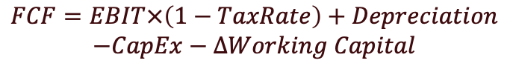
4.1 FCF Forecast Result of Practical Measurement Method
Year | 2023E | 2024E | 2025E | 2026E | 2027E
Domestic Revenue Growth Rate | 10% | 12% | 12% | 12% | 12%
International Revenue Growth Rate | 35% | 40% | 38% | 35% | 35%
TOP TOY Revenue Growth Rate | 35% | 45% | 40% | 35% | 35%
$$FCF=EBIT×\left(1−TaxRate\right)+Depreciation$$
$$−CapEx−∆Working Capital$$
Million RMB | 2022A | 2023E | 2024E | 2025E | 2026E | 2027E
Oversea Revenue | 2,354 | 3,178 | 4,449 | 6,140 | 8,289 | 11,190
China Mainland Revenue | 7,201 | 7921.1 | 8871.6 | 9936.2 | 11128.6 | 12464.0
TOP TOY Revenue | 438 | 591.3 | 857.4 | 1200.3 | 1620.5 | 2187.6
Total Revenue | 9993 | 11690.3 | 14178.1 | 17276.3 | 21037.6 | 25841.2
Gross Margin | 0.3 | 0.3 | 0.4 | 0.4 | 0.4 | 0.4
Gross Profit | 2997.9 | 3857.8 | 4962.3 | 6392.2 | 8204.7 | 10078.0
Operating Expense Ratio | 21% | 20% | 20% | 20% | 20% | 20%
Operating Expense Ratio | 2098.5 | 2338.1 | 2835.6 | 3455.3 | 4207.5 | 5168.2
Profit Before Tax | 899.4 | 1519.7 | 2126.7 | 2937.0 | 3997.2 | 4909.8
Tax Rate | 29.5% | 35% | 35% | 35% | 35% | 35%
Net Profit | 638.2 | 987.8 | 1382.4 | 1909 | 2598.1 | 3191.4
Million RMB | 2022A | 2023E | 2024E | 2025E | 2026E | 2027E
CFO | 1514.40 | 1441.55 | 2330.38 | 2897.84 | 3461.18 | 4118.78
Net Profit | 638.17 | 1111.34 | 1559.03 | 2157.89 | 2632.83 | 3240.36
D&A | 389.87 | 365.14 | 344.87 | 331.19 | 320.51 | 308.96
Changes in Non-Cash Working Capital | -420.03 | 34.93 | -426.48 | -408.76 | -507.83 | -569.46
CapEx | -1234.21 | -175.79 | -215.39 | -227.10 | -206.09 | -216.19
FCF | 398.83 | 1265.8 | 2114.98 | 2670.7 | 3255.1 | 3902.6
Data Source: MINISO Prospectus (2022.06.30), Wind

Slide 24
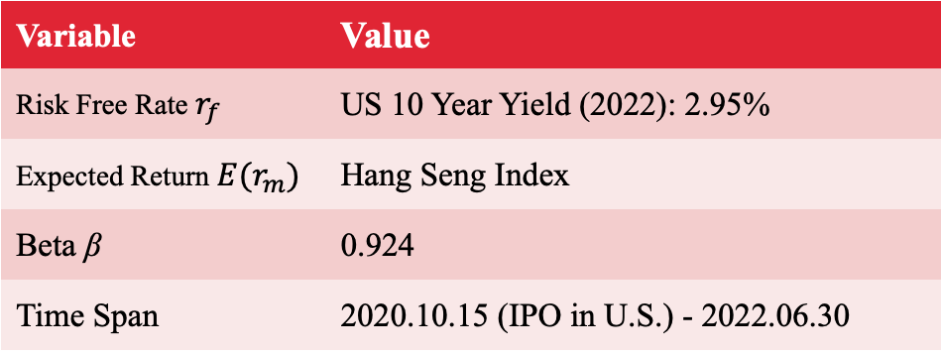
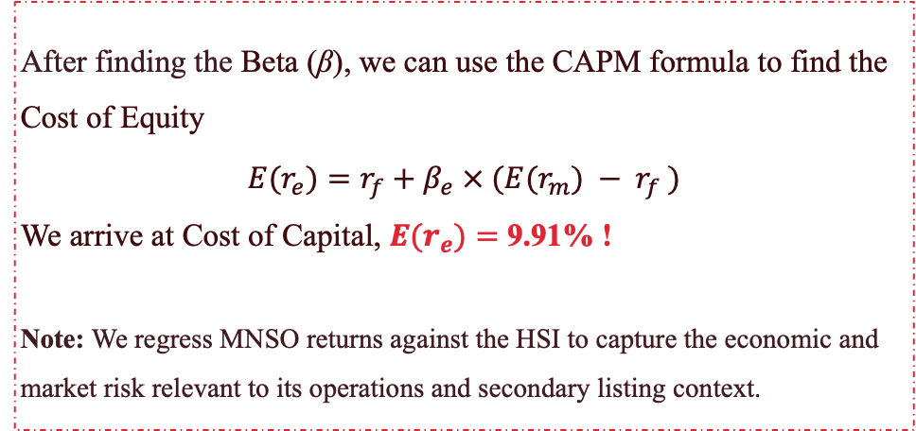
4.2.1 Fundamental Valuation: CAPM to Get Cost of Equity
Regression Process
CAPM
Beta (β) represents how much a stock's return tends to move relative to the return of the overall market.
We used linear regression to estimate MINISO's beta relative to the Hang Seng Index, by using daily returns over the period of MINISO’s initial IPO in the US (MNSO).
Variable | Value
Risk Free Rate $r_{f}$ | US 10 Year Yield (2022): 2.95%
Expected Return $E(r_{m})$ | Hang Seng Index
Beta β | 0.924
Time Span | 2020.10.15 (IPO in U.S.) - 2022.06.30
$$r_{MNSO}=β_{MNSO} × r_{HSI}+ α$$
After finding the Beta (β), we can use the CAPM formula to find the Cost of Equity
$$E(r_{e})=r_{f}+β_{e} × (E(r_{m}) − r_{f} )$$
We arrive at Cost of Capital, $E(r_{e})=$ 9.91% !
Note: We regress MNSO returns against the HSI to capture the economic and market risk relevant to its operations and secondary listing context.
α = -0.0012, β = 0.924
Fig 4.1 Regression Result.
Data Source: MINISO Prospectus (2022.06.30), Bloomberg

Slide 25
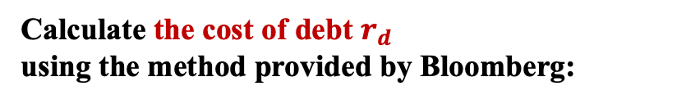
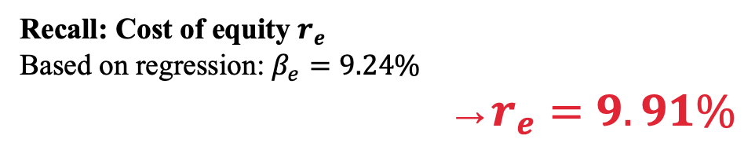

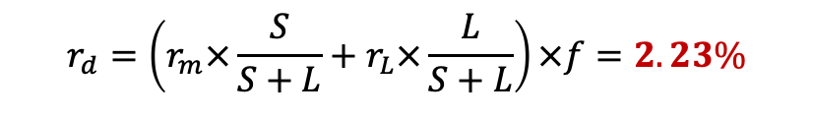
4.2.2 Fundamental Valuation: Compute WACC
Variable | Value
Short-term Debt | 258.4
Long-term Debt | 399.6
Debt (with interest) | 658.013
Equity | 7027.4
Preferred equity | 0
Effective tax rate | 29.5%
Mid-term Bond Rate | 1.5%
Bond Rate | 1.7%
Debt Ratio Adjustment Factor | 1.38
Assumption: After 2022, the company is no longer affected by the pandemic, and its capital structure (debt/equity ratio) and risk profile remain stable.
Recall: Cost of equity $r_{e}$
Based on regression:$β_{e}=9.24\%$
→ $r_{e}=9.91\%$
$$WACC=r_{d}×\left(1−τ\right)×\frac{D_{i}}{D_{i}+E}+r_{e}×\frac{E}{D_{i}+E}$$
Note: Millions of RMB per share/unit
Calculate the cost of debt $r_{d}$
using the method provided by Bloomberg:
WACC = 9.21%
$$r_{d}=\left(r_{m}×\frac{S}{S+L}+r_{L}×\frac{L}{S+L}\right)×f=2.23\%$$
Based on the assumptions, the WACC in 2022 is used as the valuation parameter for subsequent periods.
WACC in 2021 = 9.0%.
Data Source: MINISO Prospectus (2022.06.30), Bloomberg

Slide 26
4.2.3 Fundamental Valuation: Result
Key Assumptions
MINISO will recover from COVID-19 shocks, and grow at forecasted rates.
COVID-19 supply chain and lockdown policies reflected heavily in 2022 FCF data.
We will create a normalized FCF for the base year by using 2021 CAGR.
Two valuations for estimated range.
Conservative Valuation: Prospectus Est. CAGR
Optimistic Approach: Forecasted FCF
Year | Estimated FCF
2023 | 1280.48
2024 | 1462.309
2025 | 1669.956
2026 | 1907.09
2027 | 2177.897
2028 (n+1) | 2487.158
Year | Estimated FCF
2023 | 1265.764
2024 | 2114.984
2025 | 2670.744
2026 | 3255.089
2027 | 3902.583
2028 (n+1) | 4456.749
NPV of FCF | 6425.062
Terminal value | 40115.46
Perpetual growth rate | 3.00%
PV of terminal value | 25834.41
Enterprise value | 32658.3
Net Debt | -4901
Equity value | 27757.3
Shares Outstanding | 1266.67
Per Share Value | ¥21.91
NPV of FCF | 9786.152
Terminal value | 71883.1
Perpetual growth rate | 3.00%
PV of terminal value | 42392.7
Enterprise value | 52577.6
Net Debt | -4901
Equity value | 47676.6
Shares Outstanding | 1266.67
Per Share Value | ¥37.63
Baseline FCF Calculation
Year | Miniso FCF | CAGR
2020 | 901.58 | --
2021 | 981.84 | 8.9%
2022 | 398.83 | -59.3%
FCF CAGR was -59.3% in 2022, this data CANNOT be used to estimate base year FCF.
Prospectus FCF CAGR: 14.2%.
981.84*(1+14.2%) = 1121.26 (2022 FCFe)
Data Source: MINISO Prospectus (2022.06.30), Bloomberg

Slide 27
4.3 Relative Valuation: Method
Compared with discount retailers in America and Japan.
Main Comparison Ratios: EV/EBITDA, P/E Ratio, P/S Ratio.
Observed mean of ratios and compared to MINISO multiples.
Below
Company | EV (USD) | EBITDA (USD) | EV/EBITDA | Revenue (USD) | P/S | Net Income | P/E
Muji (TSE: 7453) | 2.62B | 442.8M | 5.92 | 3.91B | 0.69 | 194M | 13.98
Dollar Tree (DLTR) | 43.18B | 3.04B | 11.99 | 28.33B | 1.19 | 1.62B | 20.86
Dollar General (DR) | 68.9B | 4.06B | 14.36 | 37.84B | 1.36 | 2.42B | 21.36
Five Below (FIVE) | 11.98B | 461.36M | 22.72 | 3.08B | 3.54 | 261.53M | 41.61
Miniso (MNSO) | 1.65B | 182.07M | 8.52 | 1.56B | 1.55 | 98.86M | 24.50
What is the investment thesis?
High growth potential in TOPTOY and overseas expansion.
Our estimates, and Prospectus CAGR for TOPTOY are both 35-40% YoY.
Assuming Covid-19 restrictions for overseas stores are less restrictive in the future, overseas operations CAGR is estimated at ~35%
High growth rates in these parts of Miniso’s operations can justify a higher premium: P/E Ratio
Method | Mean | MNSO
P/E | 24.462 | 24.5
EV/EBITDA | 12.702 | 8.52
P/SALES | 1.666 | 1.55
MINISO’s valuations are average, with EV/EBITDA being undervalued.
Data Source: MINISO Prospectus (2022.06.30), Bloomberg

Slide 28
4.4.1 Conclusion: Result Summary
Valuation Method
Predicted Price
Assumptions
Lower Bound
Upper Bound
WACC: 9.21%
Lower Range: FCF-to-revenue ratio
Upper Range: Estimated FCF from revenue CAGR.
DCF
21.9
37.6
P/S
Price to Sales ratio.
Multiple Range: 0.69x - 3.54x
(Est. Revenue/Shares)*P/S Range
7.16
36.4
P/E
36.7
Price to Earnings ratio.
Multiple Range: 13.98x - 41.61x
EPS*Multiple
12.2
EV/EBITDA
Multiple Range: 5.92x - 22.72x
Equity Value/Outstanding Shares
7.37
30.5
Conclusion
Comparing valuation methods to find reasonable price range.
IPO price of HK$13.8, stock downside is low, while upside is large.
IPO Price
Predicted Stock Range
¥ 12.17 - 35.23 (HK$ 12.17 - 35.23)
Data Source: MINISO Prospectus (2022.06.30), Bloomberg

Slide 29
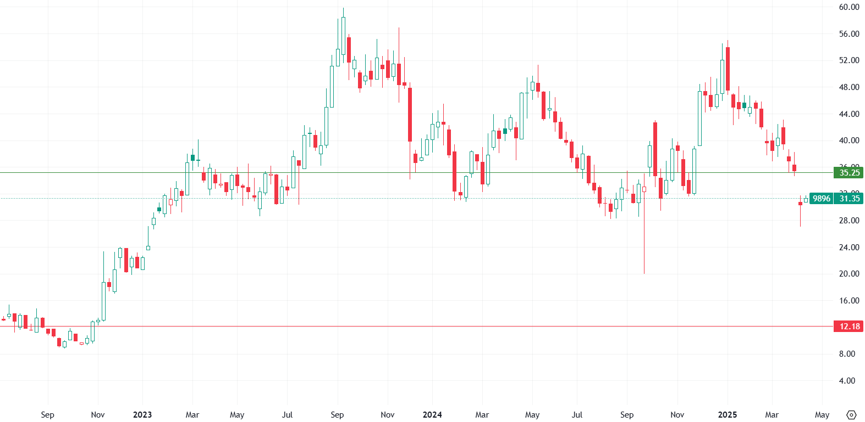
4.4.2 Conclusion: Predicted Price Range vs Actual Price
Actual stock performance from IPO (July 13, 2022) to current price.
First ~ 10 weeks, price is at the lower bounds.
After, price rises and converges to the upper bound for 20 weeks.
MINISO (9896.HK) converges to the upper bound 5 times from the IPO date to the present.
More than 60% of the time, price is within our estimated bounds. Very accurate!
MINISO 9896.HK
20 weeks
20 weeks
Data Source: MINISO Prospectus (2022.06.30), Bloomberg

Slide 30






4.4.3 Conclusion: Risk Assessment
Comprehensive Assessment：Low Bankruptcy Risk:
Unlikely in the near term if strategies are executed and inventory well managed.
With a deliberate reduction in inventory proportion, the company maintains resilience even if the pandemic persists long-term or consumer recovery falls short of expectations.
Current ratio = 2.56
I.A.R = 15%
Financial and Operational Risks
Short-term risks are manageable, but vigilance is required against liquidity risks.
Current ratio >1.5, well above the bankruptcy warning threshold (typically <1.0 signals danger).
2022
Current ratio 2.1
This reflects the company's shift from a "conservative defense" stance to "proactive expansion", while still maintaining a safety margin.
2021
I.A.R means Inventory to Current Assets Ratio
2020
Current ratio 2.6
The company demonstrates extremely strong short-term solvency
FURTHER
2019
Current ratio 1.5
During the pandemic, the retail industry generally encountered liquidity pressures, but a 1.5% demonstrates preliminary risk resilience.
Aggressive Expansion
Current ratio 1.4
Brand positioning controversy declining single store revenue, and adaptability issues in sinking markets
Facing Challenges
Conservative Defense
If it continues to be affected by the pandemic
Current Ratio = 1.67
I.A.R = 21.4%
Even amid persistent declines, with current assets plummeting and liabilities rising, the company maintains a robust defensive position with a ratio still above 1.5.
Impact of the Pandemic
Declining Revenue
TOP TOY
Intensifying competition
Frequent incidents Strategic adjustment
1. Domestic MINISO continues to expand into lower-tier markets;
2. Brand globalization with a high-quality supply chain;
3. TOP TOY is in a rapid expansion phase
Measures for shocks

Slide 31
05
Extension
Can you think of a trading strategy to profit from this deal ?

Slide 32
4.1 Strategy One: Learn Corporate Finance !
Predicted Stock Range
¥ 10.21 - 35.23 HK$ 11.84 - 40.87
It's much more likely to be at a high level.
Buy MINISO directly after listing and wait for the rose of time to bloom.

Slide 33
4.2 Strategy Two: Quantitative Strategy for HF Trading !
Select highly correlated stock
consumer goods
retail
trendy toy
Features
Momentum
Valuation
Alpha101
Alpha191
Model
Random Forest
Transformer
Recurrent Neural Network
History data from
NYSE & HKEX
& other EX
Develop T+0 high-frequency trading strategies based on past data of underlying stocks.

Slide 34
Conclusion
Was MINISO's IPO a Good or Bad deal ?
This is a GOOD Deal for both the Company and Investors !
Company Analysis
Industry
Business
Finance
IPO Overview
Issue Shares
Issue Price
Raise Money
Valuation
Fundamental
Relative
MINISO Profile
Description
Development Path
Extension
Quantitative Trading Strategy
Notes:
Step by step, after all of the analysis, we can clearly answer this Question, The IPO of a good deal both for the Company and Investors.
Company meets the requirment and inverstors Investors can choose to enter at lower points.

Slide 35
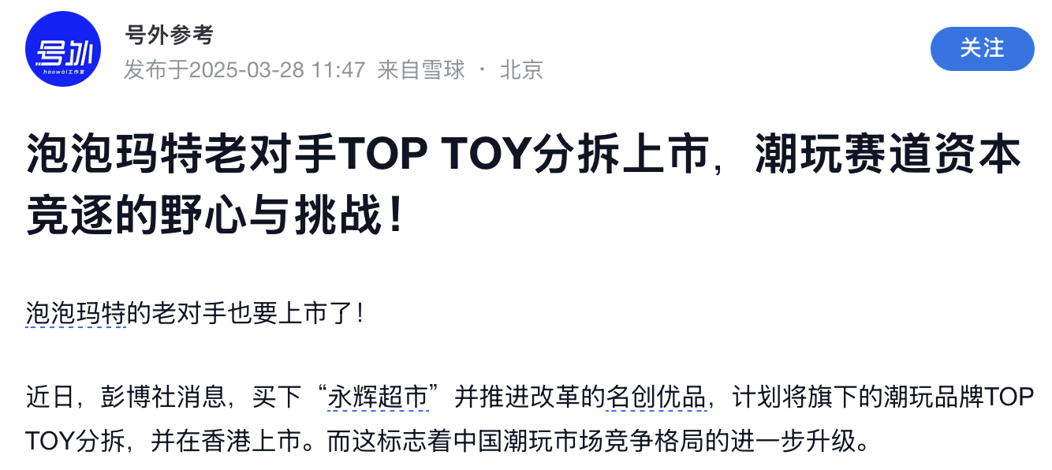
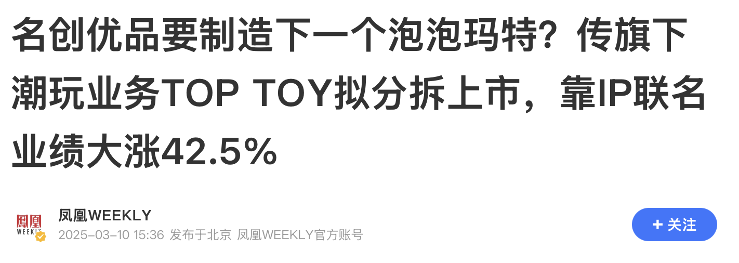
9896.HK
MINISO
THANK YOU
April 17th, 2025
Group 3: Kai Ren, Yang Lan, YiMing Jiang, Rui Hu, Gary Li, WeiJie Zhang
(Ordered by Pre)
Notes:
Thanks to Prof. Shi, we have gained a deeper understanding of the actual valuation issues during this IPO analysis.
Valuation is definitely not a numbers game, and accurate forecasting of FCF requires an extremely deep understanding of both a company and the industry in which it operates in order to find the core growth points.
Top Toy will be available soon, will you be able to take advantage of the opportunity?
Thank you all!!

